Slide 1
Automatically Identifying Patterns and Novel Behaviours in the RF Environment at DRAO
Stephen Harrison
August 19, 2019
9th Montreal Industrial Problem Solving Workshop

Slide 2
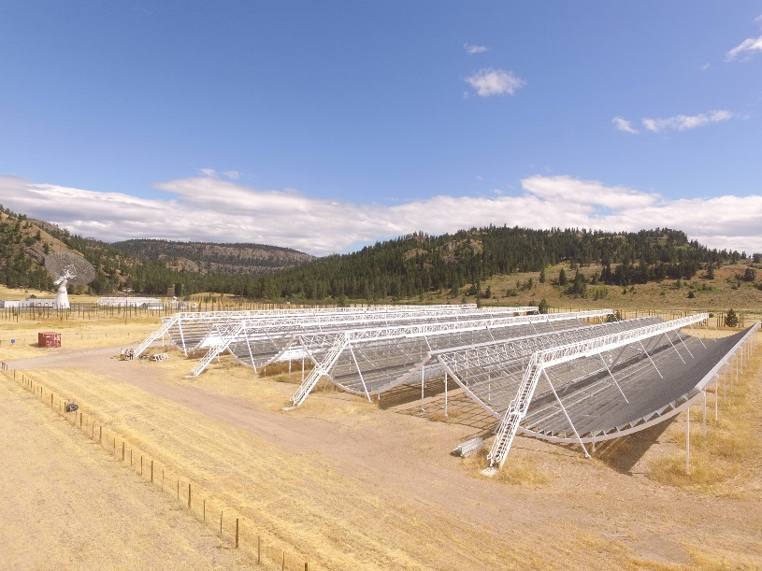
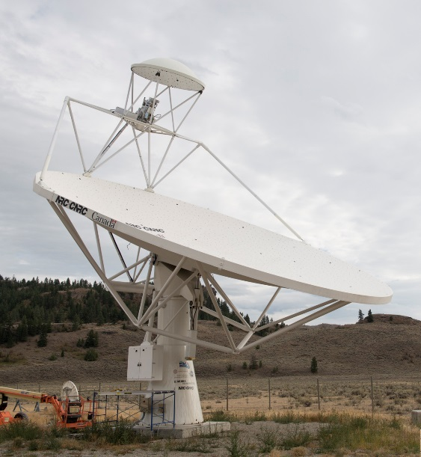
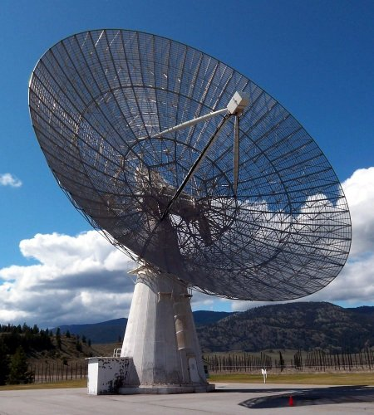
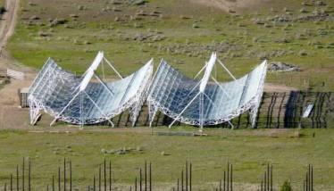
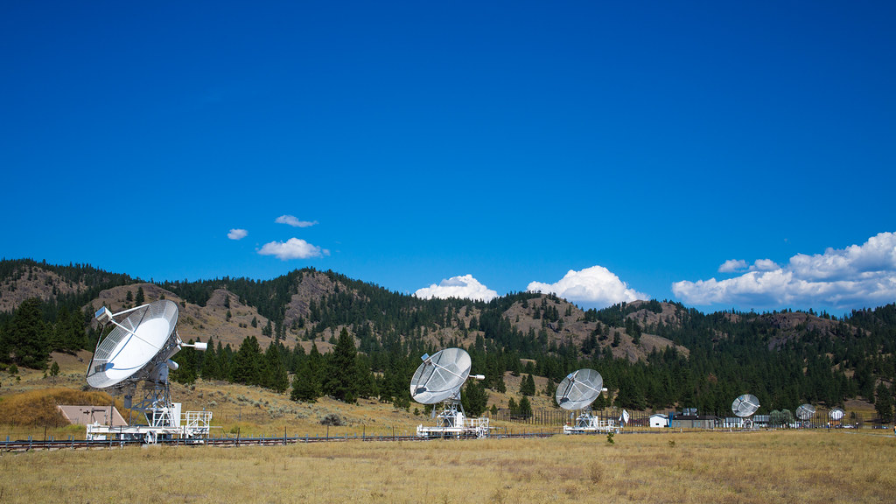
The Dominion Radio Astrophysical Observatory (DRAO)
Canadian Hydrogen Intensity
Mapping Experiment (CHIME)
400-800 MHz
Dish Verification
Antenna (DVA)
350 MHz - ???
John A. Galt 26m
900-1800 MHz
CHIME Pathfinder
400-800 MHz
DRAO Synthesis Telescope
408 and 1420 MHz
Solar Flux Monitoring
Technology Development
Antenna Test Facilities
Dish Fabrication
…and more.
Notes:
A national radio astronomy observatory and NRC research facility since 1959.
DVA antenna – Attempting to achieve surface accuracy in order to receive at >100 GHz (3mm wavelength).

Slide 3
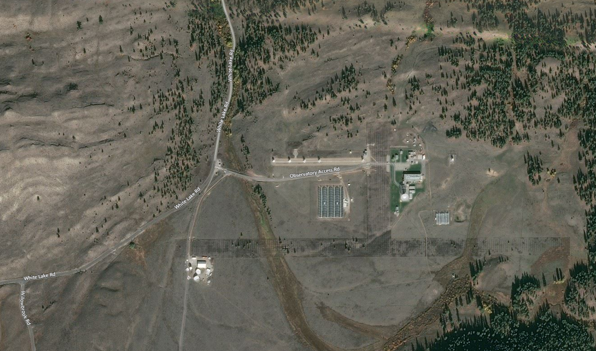
Radio Frequency Interference at DRAO
St. Andrews
Golf Course (2 km),
Penticton (20 km)
Ourselves (0 km!!!)
Twin Lakes
Golf Course (8 km)
OK Falls,
Cell Towers (5 km)
Oliver (16 km)
Notes:
Astronomical signal are so weak that emissions from terrestrial sources make it impossible to observe at those frequencies.
Some sources of interference as near as 2km
Staff, contractors, and visitors often bring RF-emitting equipment on site. Our site is open to the public.
Most equipment is not designed for an RF-quiet site.

Slide 4
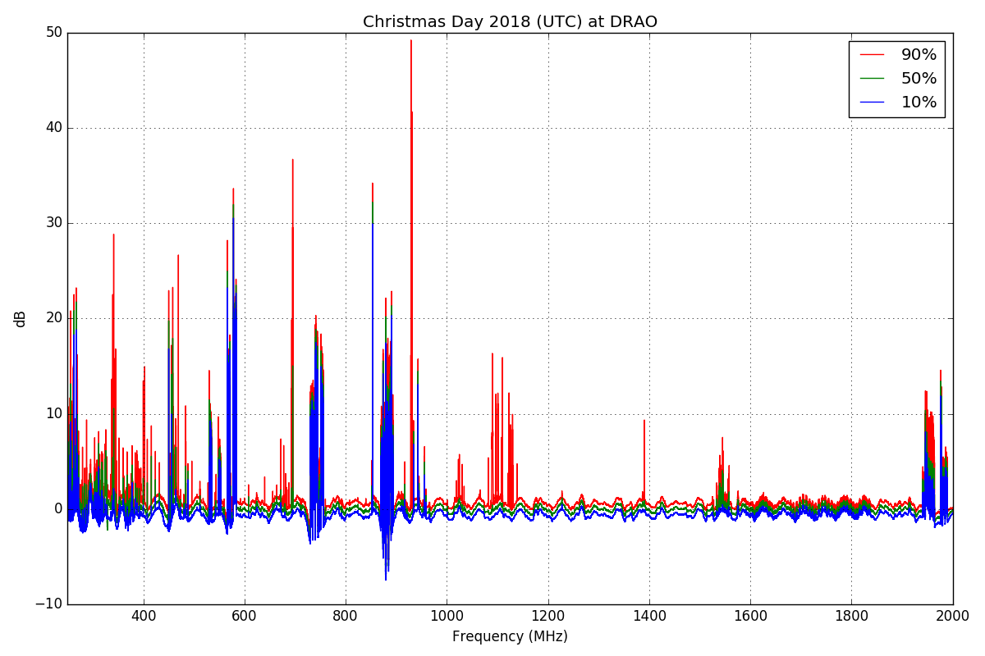
The Static RF Scene
This type of survey is a simple statistical characterization.
The probability distribution of received RF power over frequency.
The RF spectrum as seen from DRAO is a very busy place!
How can we understand this very dynamic environment?
TV
850 MHz
Cell
750 MHz
Cell
Pager
Service
Aircraft
1900 MHz
Cell
Notes:
A survey of 250 – 2000 MHz.
Point out: TV stations, 750 MHz cell band, 850 MHz cell band, Pager Tower, Aircraft navigation, 1900 MHz cell band.

Slide 5
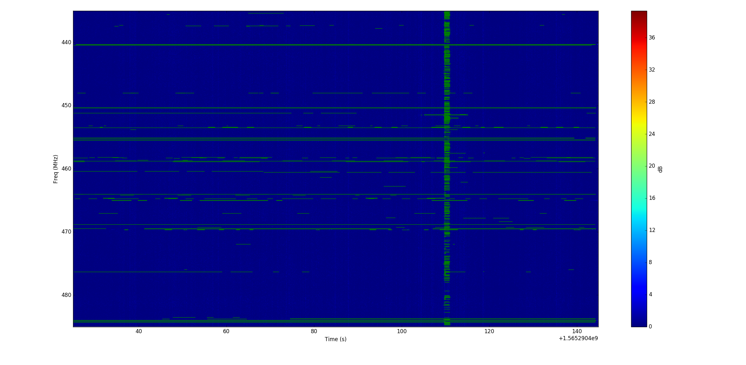
The Dynamic RF Scene
Detection of RFI in time-frequency space. ML bounding box approach.
Notes:
50 MHz for 2 minutes. This is the data we brought, 30 files like this (1 hour of observing). We want to observe 2000 MHz for all day every day.
1kHz frequency resolution
100ms time resolution. We would like to observe higher cadence.
Bounding box approach tries to draw a box around the frequency and time range in which one signal exists.
Point out vertical stripe: Some electrical equipment generates a short wideband burst of RF energy. This is a different class of events, but we are interested in characterizing them.

Slide 6
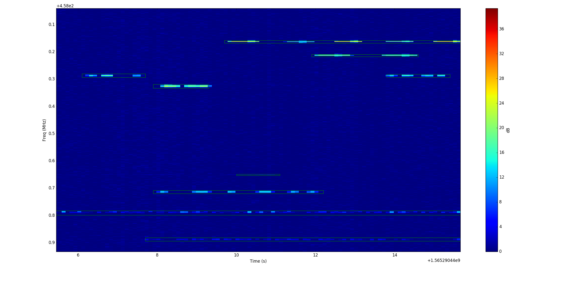
The Dynamic RF Scene

Slide 7
What Is Interesting Here?
To detect what is novel we must first understand what is normal.
We cannot sift through this volume of data manually.
We must be able to detect a new source appearing in the scene.
Unsupervised learning techniques (e.g.: hierarchical clustering, outlier detection) organize the data for us.
Organized around features of each detected event: Frequency, Bandwidth, Received Power, Duration, Modulation Statistics, Channel Statistics, Time of Day, Day of Week, etc.
These features have physical meaning for people working in the field to locate sources of RFI.

Slide 8
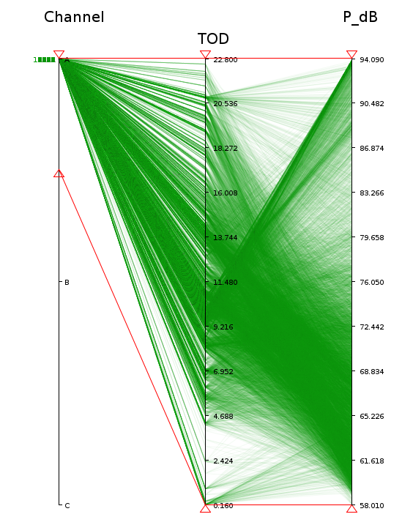
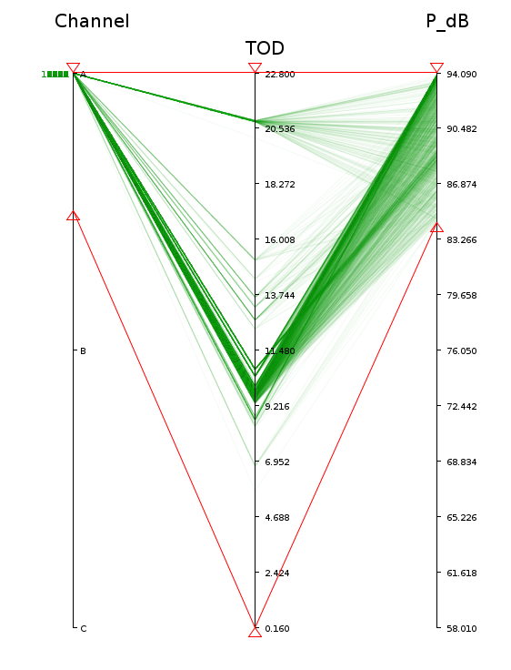
What Can We Learn From Patterns?
One cellular uplink channel is monitored over a period of a week.
Time of day (TOD) is plotted against received power (P_dB).
Density in the received power axis indicates a bimodal distribution.
Highest power detections are associated with working hours, specifically in the morning as staff arrive.
The lower power detections occur throughout the day.
Notes:
We knew about this pattern for ages, but we need real DATA as evidence to inform policy.

Slide 9
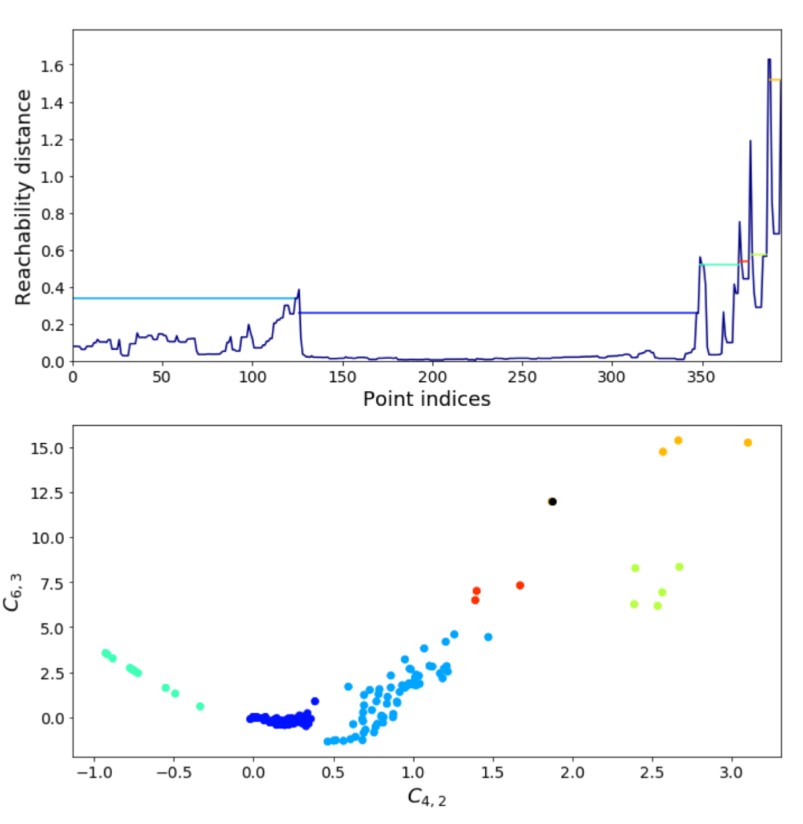
Hierarchical Clustering (1)
We have used a variant of OPTICS to cluster the data.
OPTICS produces a “reachability plot” that orders points based on the “distance” between them.
Clusters are indicated visually by valleys in the reachability plot.
Various methods exist to predict clusters from the reachability plot.
Works (ok) in high dimensions.
Works when some dimensions are not relevant for some clusters.

Slide 10
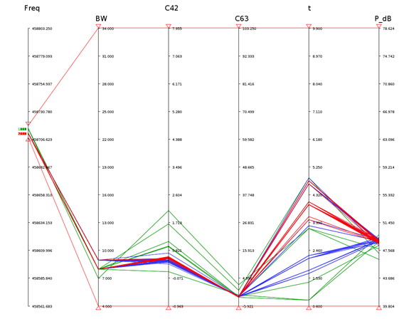
Hierarchical Clustering (2)
Clustering in six dimensions:
Center Frequency
Bandwidth
Cumulants C_{4,2}, C_{6,3}
Transmission Duration
Received Power
Hierarchical clustering:
Red and blue groups are children of the green group.
Many more dimensions we would associate with RFI!

Slide 11
Our Question: What unsupervised learning techniques can we apply to identify clusters, patterns, and outliers?
Clusters allow us to study populations of events to reveal patterns, rather than studying:
targeted experiments (such as cell uplink experiment – we knew this already)
individual events in isolation, without context, often weeks/months after the data was collected
mean/max spectra, which discards a wealth of information about the events
Outliers tell us about new arrivals on the RF scene:
is this transient or does it become a new cluster?
should we deploy our limited personnel in the field to “hunt” for this emitter?

Slide 12
Resources
One hour of pre-processed radio data files in HDF5 format:
Integrated Power Spectra @ 100ms cadence, 1kHz resolution
(Time, Frequency) bounding boxes.
Extracted feature vectors:
Center Frequency
Bandwidth
C_{4,2}, C_{6,3}
Transmission Duration
Received Power
Raw time series associated with all HDF5 files.
16b+16b Complex Samples @ 50 MSPS.

Slide 13

Questions?
Stephen Harrison
Digital Systems Engineer
Tel: 250-497-2328
Stephen.Harrison@nrc-cnrc.gc.ca
www.nrc-cnrc.gc.ca
13

